Slide 1


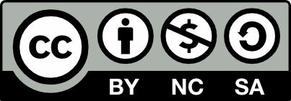

Introduction To Programming
Error handling. Exceptions.
SoftUni Team
Technical Trainers
Software University
http://softuni.bg

Slide 2

Table Of Contents
How are errors presented in C#.
Error types, and their meaning.
When do errors normally occur.
How to handle errors:
try block
catch block
finally block

Slide 3
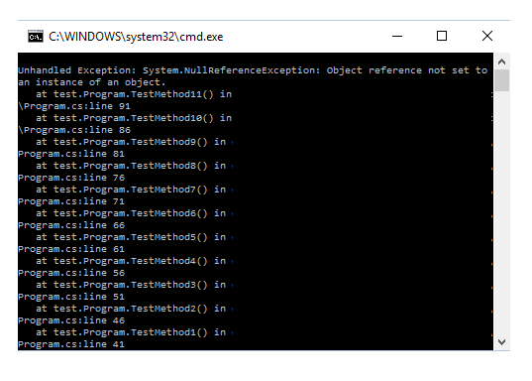
What are Exceptions?
Error conditions are an often occurrences in the execution of computer programs
When that happens, the runtime creates an object to represent the error
That object is called – an exception

Slide 4
Most Common Exception Types
ArgumentException – thrown when an operation is invoked with invalid arguments
NullReferenceException – thrown when an operation is invoked with null arguments
InvalidOperationException – thrown when an operation is invoked in invalid circumstances
FormatException – thrown when an operation that takes a specific format of arguments is invoked with arguments of different from the needed format

Slide 5
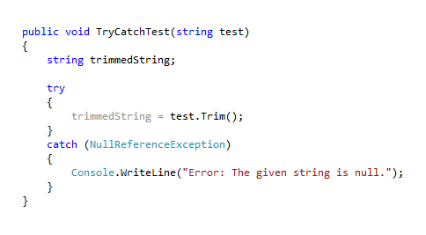
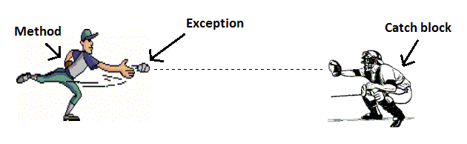
How to Handle Exceptions?
To handle an exception in C# you must use the, provided by the .NET Framework, try-catch block
The try-catch block allows you to try to execute a piece of code, and catch a specific error which is likely to occur

Slide 6
Try-Catch Block
Handling an exception is done by wrapping the piece of code, that may throw an exception, in the try block, and the code that will execute on error in the catch block
int number = 10
int divisor = 0;
try
{
int result = number / divisor;
}
catch (DivideByZeroException exception)
{
Console.WriteLine(“Error: Cannot divide by zero.”);
}
The try block
Possible exception here
The specified exception
The catch block
Code - executed on error

Slide 7
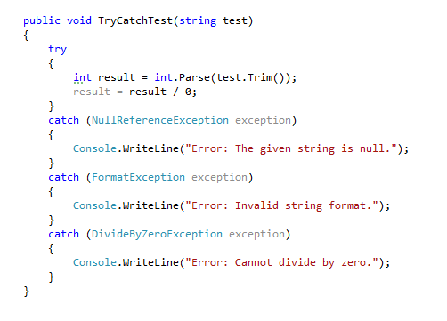
Try-Catch Block
The try-catch block supports multiple catch blocks
provides the opportunity to catch multiple exceptions
Catching multiple exceptions means covering more exceptional cases which leads to a more secured code

Slide 8
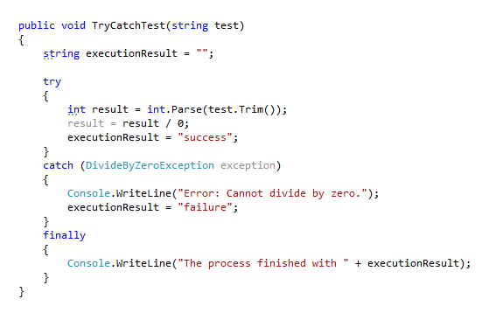
Try-Catch-Finally Block
The finally block is used in association with the try block
The finally block is always executed regardless of whether an exception is thrown
The finally block is often used to write clean-up code
The finally block

Slide 9
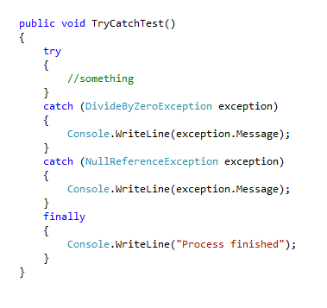

Live Demo

Slide 10
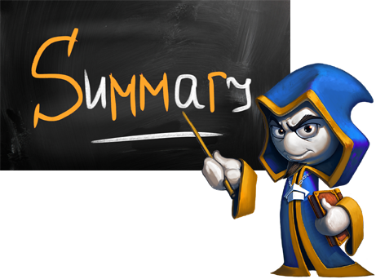
Summary
What are exceptions?
What types of exceptions can, most likely, occur in our code
What causes them and how to “catch” them
How to catch multiple exceptions in order to secure our code more
How to execute something regardless of whether an exception is thrown

Slide 11








Questions
https://softuni.bg/courses/javascript-applications/

